Slide 1



DATA PREPROCESSING
DAYATA | YAP
CS 4103 | Intelligent Systems
September 6, 2023

Slide 2

OUTLINE
INTRODUCTION
TECHNIQUES
APPLICATION
Standardization
Mean Removal
Variance Scaling
Normalization
Importance and significance
Examples
and
Exercises
CS 4103 | Intelligent Systems
September 6, 2023

Slide 3
What is data preprocessing?
CS 4103 | Intelligent Systems
September 6, 2023

Slide 4
INTRODUCTION
Data preprocessing is a fundamental step in the journey from raw data to actionable insights using machine learning models.
Techniques that transform and prepare the raw data into a suitable format for analysis and modeling.
Ensures the accuracy and effectiveness of ML models.
Addresses these challenges and enhance the quality of the data before feeding it into the models such as:
missing values, outliers, and differing scales.
CS 4103 | Intelligent Systems
September 6, 2023
Notes:
Data preprocessing is a fundamental step in the journey from raw data to actionable insights using machine learning models. It involves a series of techniques that transform and prepare the raw data into a suitable format for analysis and modeling. Raw data often contains imperfections, inconsistencies, and variations that can hinder the performance of machine learning algorithms. Data preprocessing aims to address these challenges and enhance the quality of the data before feeding it into the models. By tackling issues like missing values, outliers, and differing scales, data preprocessing plays a critical role in ensuring the accuracy and effectiveness of machine learning models.

Slide 5
Model Evaluation
Model Building
Data Exploration and Visualization
Data Preprocessing
Data Collection
and Assembly
CS 4103 | Intelligent Systems

Slide 6
NOTE:
Raw data collected from various sources is seldom ready to be used directly in machine learning models.
CS 4103 | Intelligent Systems
September 6, 2023
Notes:
Raw data collected from various sources is seldom ready to be used directly in machine learning models. It often contains noise, missing values, and outliers that can mislead the learning algorithms. Additionally, features might have different scales, making certain features dominate the learning process. Data preprocessing helps in cleansing the data by removing noise, handling missing values, and addressing outliers. It also standardizes features to a consistent scale, making the learning process smoother and more reliable.

Slide 7
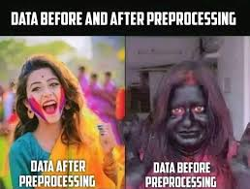
CS 4103 | Intelligent Systems
September 6, 2023

Slide 8
Techniques for Data Preprocessing
CS 4103 | Intelligent Systems
September 6, 2023

Slide 9

Data Preprocessing for Machine Learning
01
03
05
07
Rescaling Data
Standardizing Data
Normalizing Data
Binarizing Data
02
04
06
Mean Removal
One Hot Encoding
Label Encoding
CS 4103 | Intelligent Systems
September 6, 2023

Slide 10
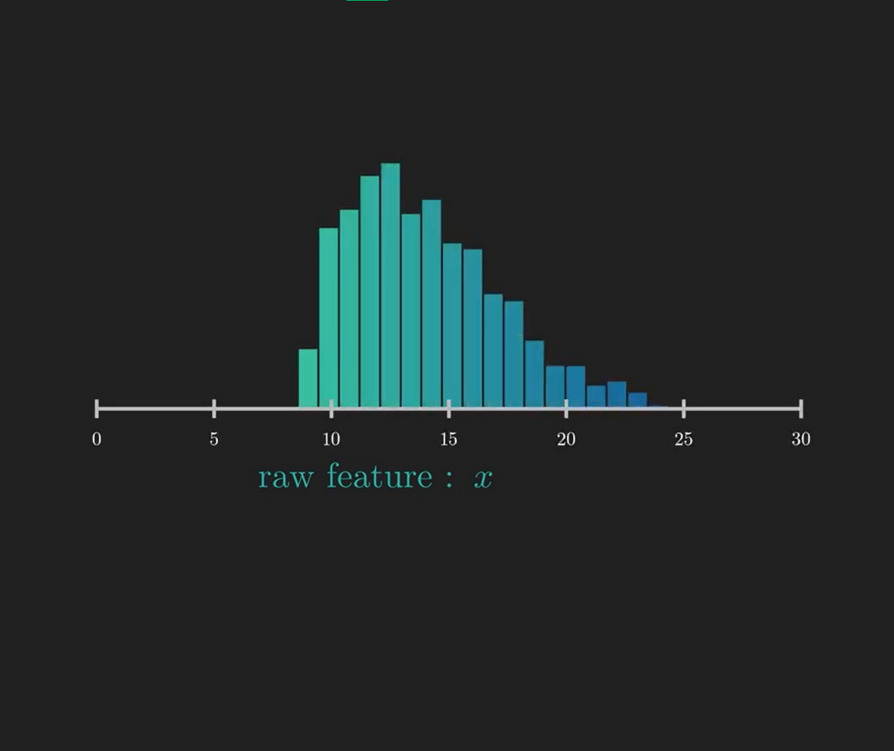
SCALING AND SHIFTING DATA

Slide 11
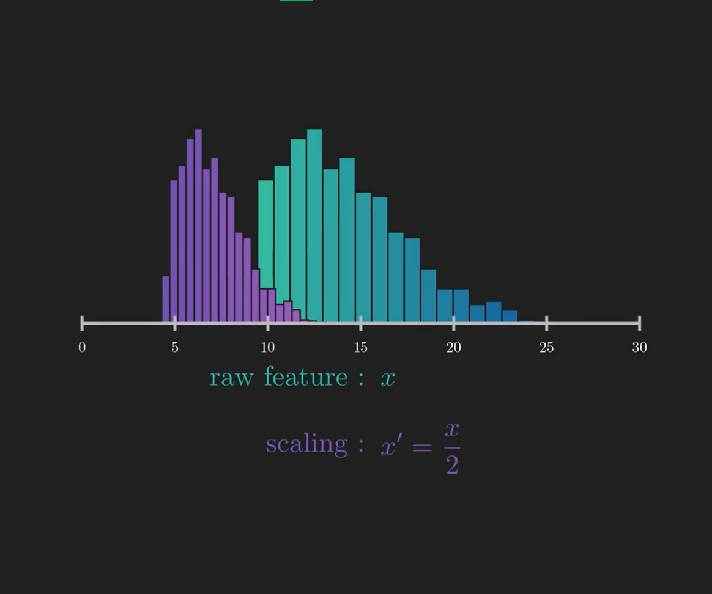
SCALING AND SHIFTING DATA

Slide 12
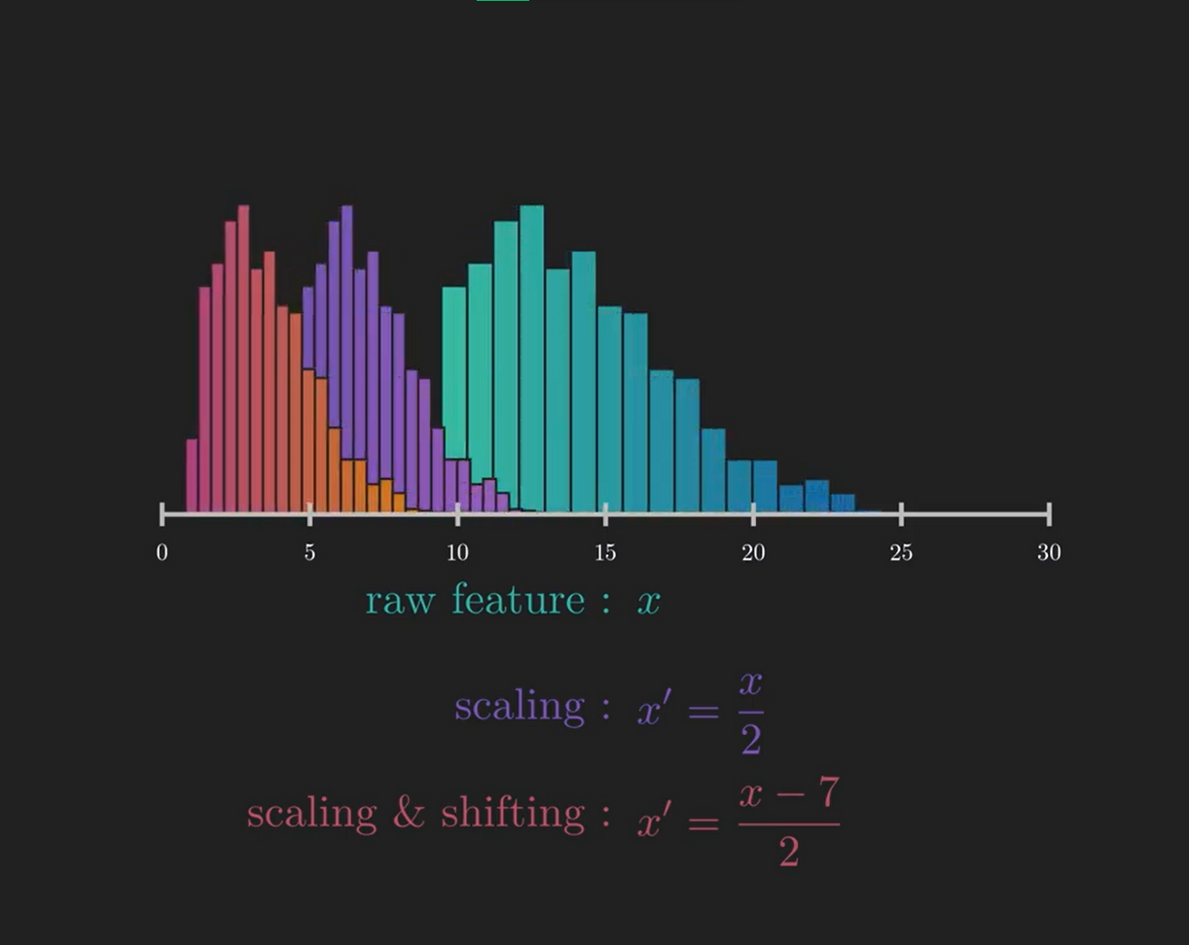
SCALING AND SHIFTING DATA

Slide 13
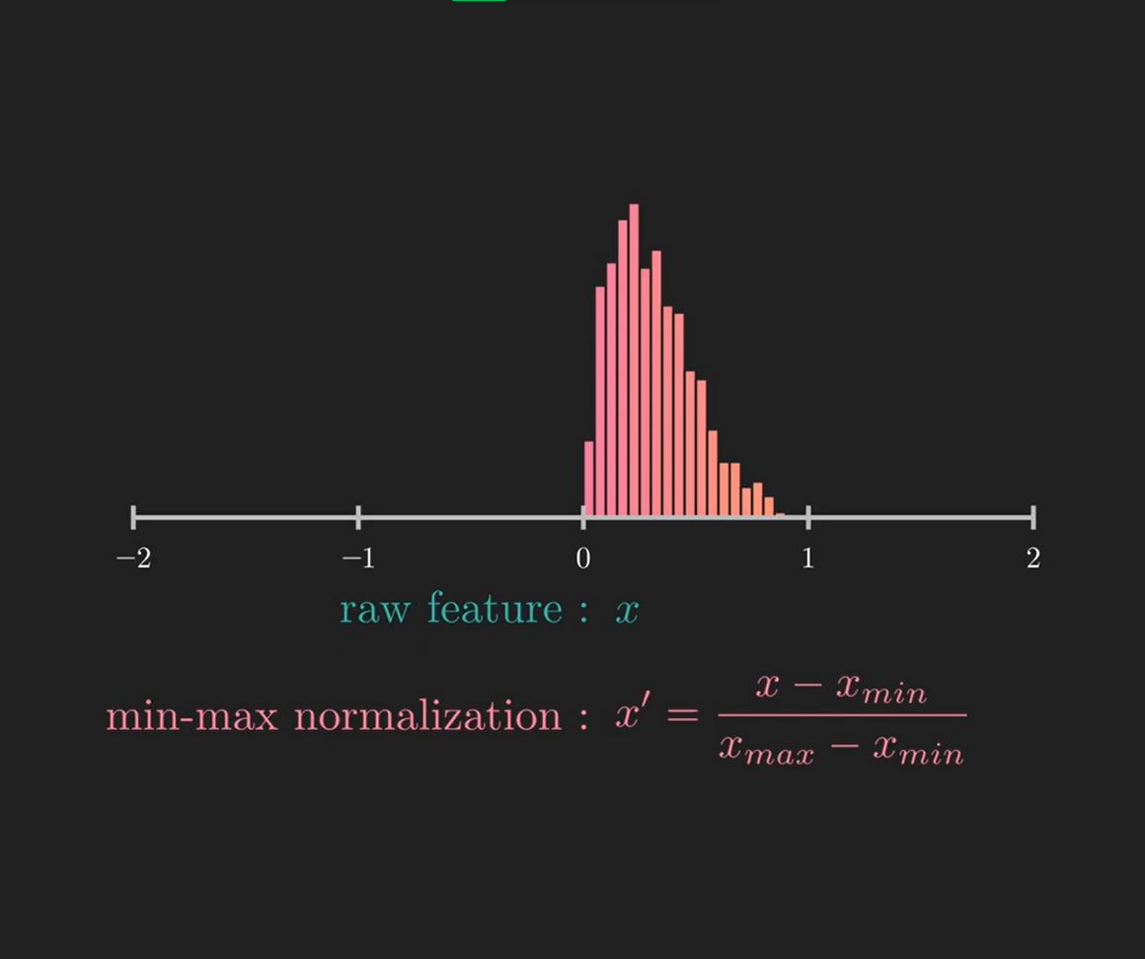
SCALING AND SHIFTING DATA

Slide 14
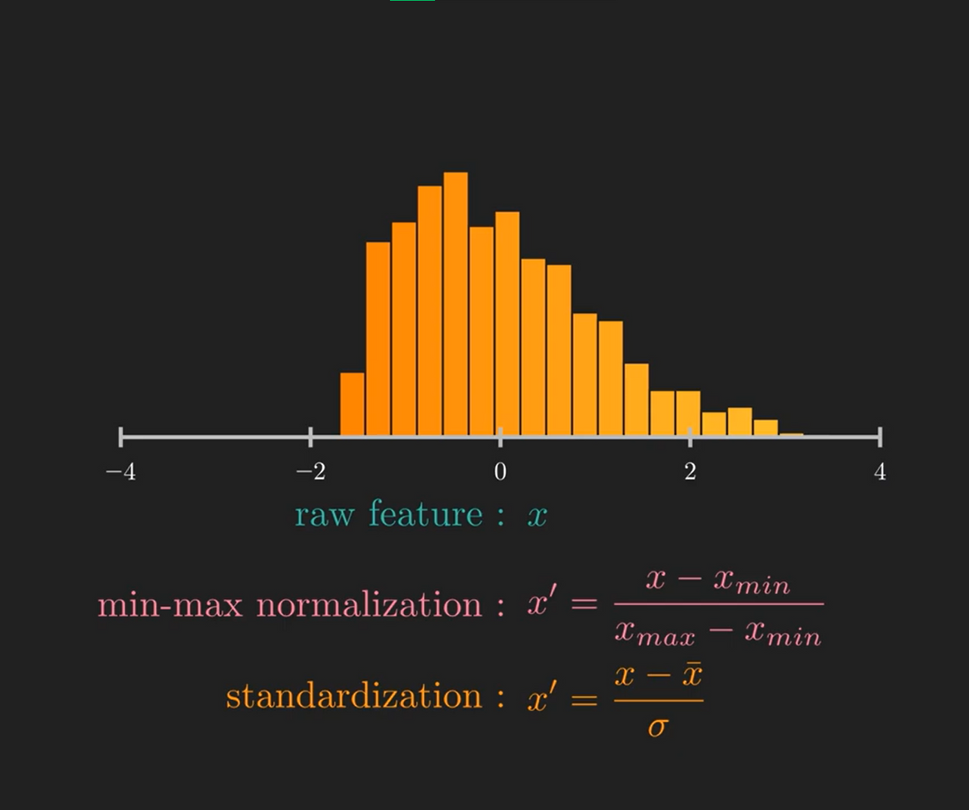
SCALING AND SHIFTING DATA

Slide 15
Why perform Feature Scaling?
CS 4103 | Intelligent Systems
September 6, 2023

Slide 16
REASONS FOR SCALING DATA
Faster Convergence
Improved efficiency and interpretability
Computing distance appropriately
CS 4103 | Intelligent Systems
September 6, 2023

Slide 17
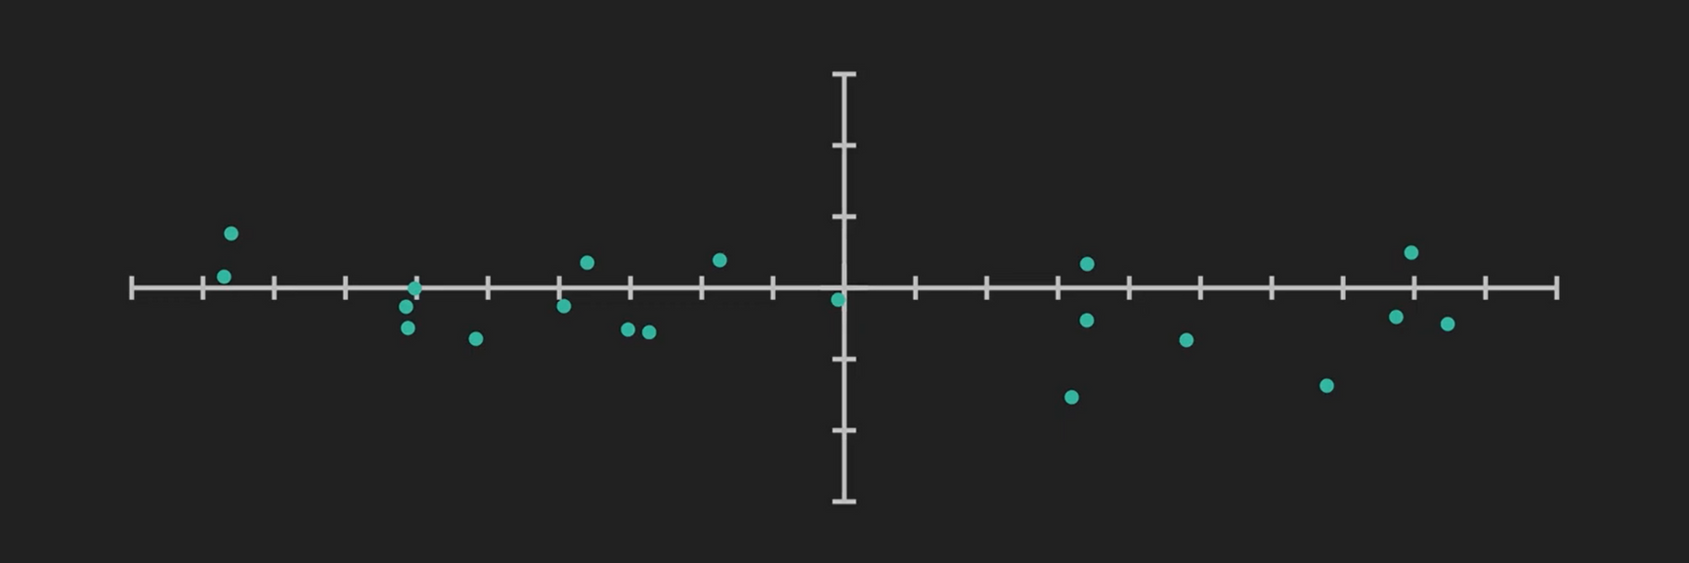

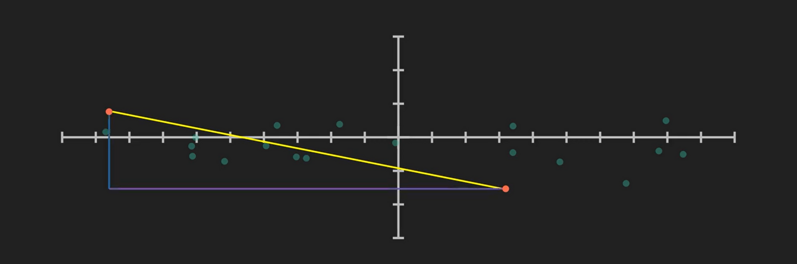

Slide 18
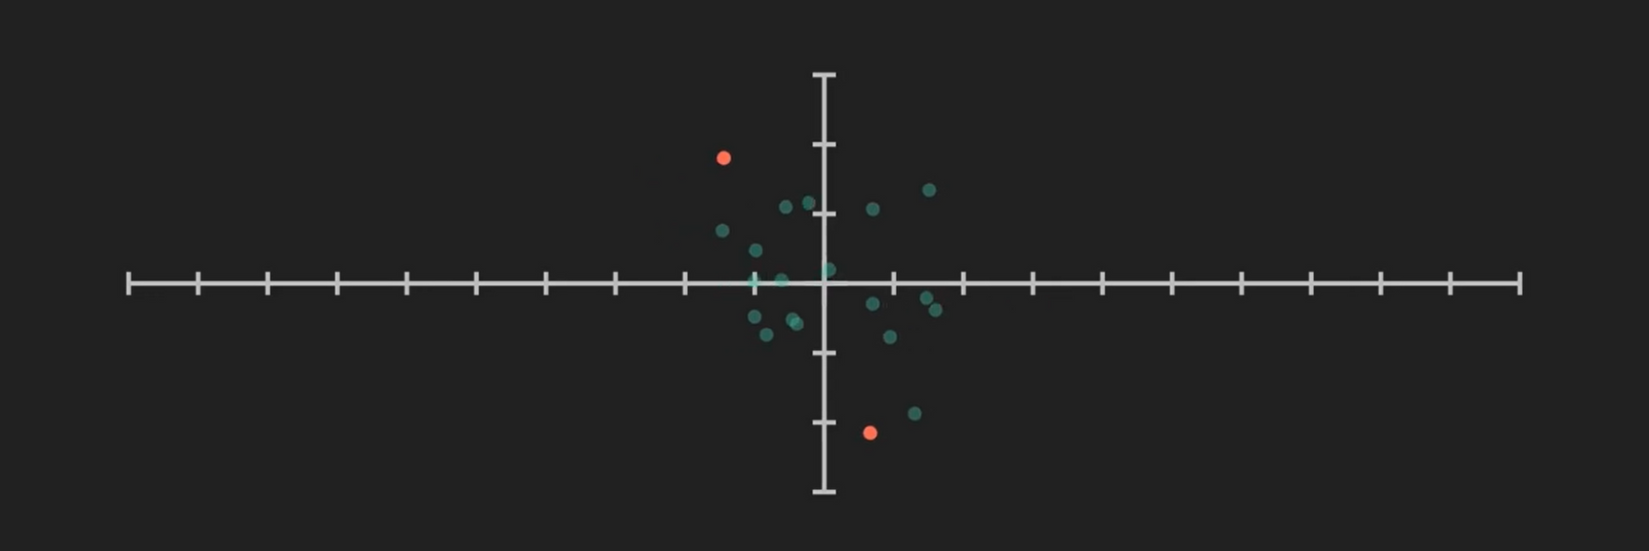
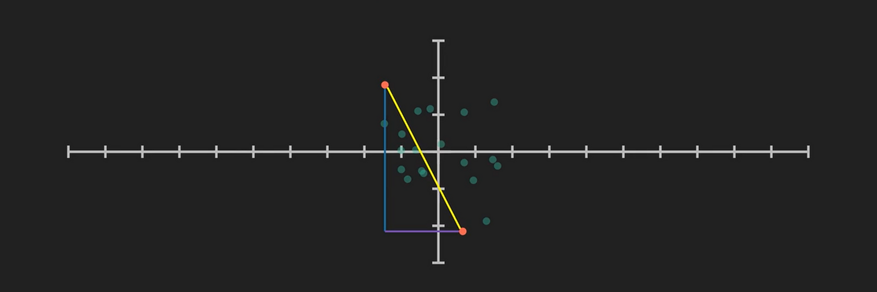

Slide 19
FEATURE SCALING
Technique to standardize the independent features present in the data in a fixed range.
Done to handle highly varying magnitudes or values or units.
If feature scaling is not done, then a machine learning algorithm tends to weigh greater values, higher and consider smaller values as the lower values, regardless of the unit of the values.
CS 4103 | Intelligent Systems
September 6, 2023
Notes:
Data preprocessing is a fundamental step in the journey from raw data to actionable insights using machine learning models. It involves a series of techniques that transform and prepare the raw data into a suitable format for analysis and modeling. Raw data often contains imperfections, inconsistencies, and variations that can hinder the performance of machine learning algorithms. Data preprocessing aims to address these challenges and enhance the quality of the data before feeding it into the models. By tackling issues like missing values, outliers, and differing scales, data preprocessing plays a critical role in ensuring the accuracy and effectiveness of machine learning models.

Slide 20
Data Preprocessing for Machine Learning
01
03
05
07
Rescaling Data
Standardizing Data
Normalizing Data
Binarizing Data
02
04
06
Mean Removal
One Hot Encoding
Label Encoding
CS 4103 | Intelligent Systems
September 6, 2023

Slide 21
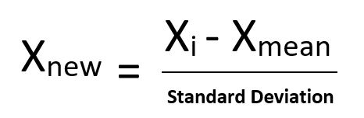
STANDARDIZATION
a.k.a. Z-Score Normalization
Transforms the data distribution to a mean of 0 and standard deviation of 1.
Helpful in cases where the data follows a Gaussian distribution.
Example Applications:
Gradient-based Optimization Algorithms
Principal Component Analysis (PCA)
Distance-Based Algorithms
CS 4103 | Intelligent Systems
September 6, 2023

Slide 22
Data Preprocessing for Machine Learning
01
03
05
07
Rescaling Data
Standardizing Data
Normalizing Data
Binarizing Data
02
04
06
Mean Removal
One Hot Encoding
Label Encoding
CS 4103 | Intelligent Systems
September 6, 2023

Slide 23
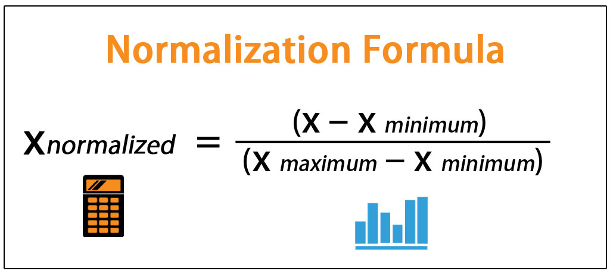
NORMALIZATION
a.k.a. Min-Max Scaling
Scales the range to [0, 1] or sometimes [-1, 1].
Useful when there are no outliers as it cannot cope up with them.
Example Applications:
Neural Networks (Inputs)
Image Processing (Pixel brightness)
Algoriths with bounded inputs
CS 4103 | Intelligent Systems
September 6, 2023

Slide 24
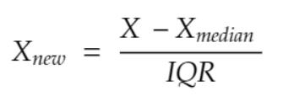
ROBUST SCALING
Utilizes median and interquartile range to scale the data (Q3-Q1)
Improved normalization method on data with several outliers.
Benefits:
Resistent to outliers
Preserves facts integrity
Robust to outliers
Handles skewed data
CS 4103 | Intelligent Systems
September 6, 2023

Slide 25
Normalize or standardize?
CS 4103 | Intelligent Systems
September 6, 2023

Slide 26
1. Exam Scores
6. Housing Prices
2. Temperature Readings
7. Sensor Data
3. Stock Market Data
8. Sales Records
4. Customer Reviews
9. IQ Test Scores
5. Health Metrics
10. SocMed Engagement Metrics
CS 4103 | Intelligent Systems
September 6, 2023

Slide 27
1. Exam Scores
6. Housing Prices
2. Temperature Readings
7. Sensor Data
3. Stock Market Data
8. Sales Records
4. Customer Reviews
9. IQ Test Scores
5. Health Metrics
10. SocMed Engagement Metrics
Normalize
Standardize
CS 4103 | Intelligent Systems
September 6, 2023

Slide 28

CS 4103 | Intelligent Systems
September 6, 2023

Slide 29
NORMALIZATION VS STANDARDIZATION
Normalization | Standardization
Minimum and maximum value of features are used for scaling | Mean and standard deviation is used for scaling
It is used when features are of different scales | It is used when we want to ensure zero mean and unit standard deviation
Scales values between [0, 1] or [-1, 1] | It is not bounded to a certain range
It is really affected by outliers | It is much less affected by outliers
Scikit-Learn provides a transformer called MinMaxScaler for Normalization | Scikit-Learn provides a transformer called StandardScaler for standardization
This transformation squishes the n-dimensional data into an n-dimensional unit hypercube | It translates the data to the mean vector of original data to the origin and squishes or expands
It is useful when we don’t know about the distribution | It is useful when the feature distribution is Normal or Gaussian
It is a often called as Scaling Normalization | It is a often called as Z-Score Normalization
CS 4103 | Intelligent Systems
September 6, 2023

Slide 30
RECAP
Data preprocessing is crucial due to challenges posed by raw data such as noise, outliers, and differing scales.
Standardization brings data to a common scale with mean 0 and standard deviation 1.
Normalization scales data to a range of [0, 1], often used with neural networks.
Choosing the right preprocessing technique depends on data characteristics and algorithm requirements.
Standardization and normalization have distinct purposes: centering vs. scaling data.
Python libraries like NumPy and scikit-learn provide tools for implementing these techniques.
Proper data preprocessing enhances model performance, but improper preprocessing can lead to issues like data leakage.
Data preprocessing is an essential step toward building accurate and reliable machine learning models.
CS 4103 | Intelligent Systems
September 6, 2023

Slide 31
Hands-on Demonstration
CS 4103 | Intelligent Systems
September 6, 2023

Slide 32
READ MORE...
https://www.geeksforgeeks.org/normalization-vs-standardization/
https://www.geeksforgeeks.org/ml-feature-scaling-part-2/
https://scikit-learn.org/stable/modules/preprocessing.html#normalization
https://www.kaggle.com/getting-started/159643 https://www.kdnuggets.com/2020/04/data-transformation-standardization-normalization.html
https://www.kaggle.com/code/durgancegaur/a-guide-to-any-classification-problem
https://subscription.packtpub.com/book/data/9781789808452/1/ch01lvl1sec05/data-preprocessing-using-mean-removal
https://www.analyticsvidhya.com/blog/2020/04/feature-scaling-machine-learning-normalization-standardization/
https://towardsdatascience.com/scale-standardize-or-normalize-with-scikit-learn-6ccc7d176a02
CS 4103 | Intelligent Systems
September 6, 2023

Slide 33
FIN
DAYATA | YAP
CS 4103 | Intelligent Systems
September 6, 2023

